Slide 1
Evolutionary and Social Contexts for Compassion
Paul Gilbert PhD, FBPsS, OBE
Mental Health Research Unit, Kingsway Hospital Derby
p.gilbert@derby.ac.uk
www.compassionatemind.co.uk
www.compassionatewellbeing.com

Slide 2

Compassion begins with a reality check
Insight builds wisdom
We are gene-built - with evolved brains designed to struggle to survive, to want, grasp and avoid pain
We are all born, grow, decay and die - and are susceptible to many diseases and injuries – life with tragedy –pain and suffering
We are socially shaped – from our gene expressions, to our sense of self and values
Not our fault – but how to choose to train the mind (powerful de-shame process)
Notes:
2

Slide 3
Compassion:
Challenges of Our Evolved Brain and the
Distressed Mind
Notes:
3

Slide 4
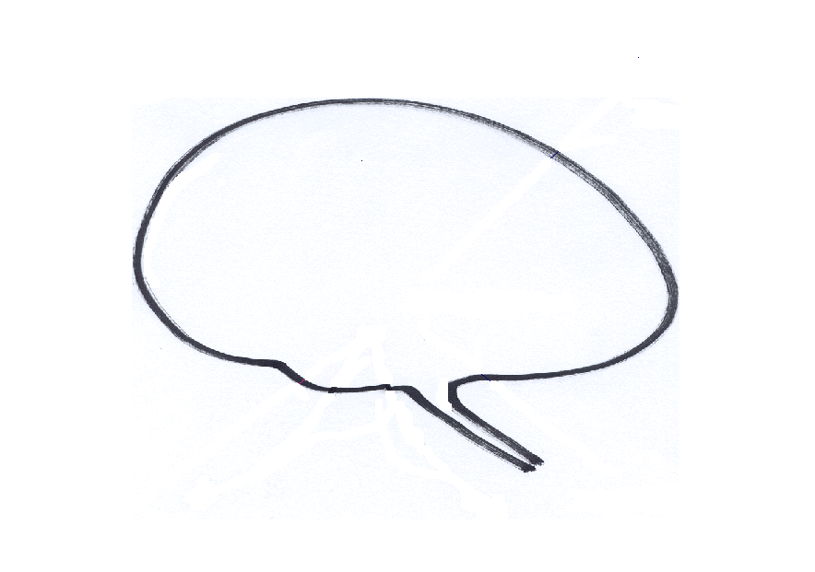
Sources of behaviour
Old Brain Psychologies
Emotions
Fear, Anxiety, Anger, Lust, Joy
Social Motives
Closeness, Belonging, Sex, Status, Respect
Old Brain

Slide 5
Sources of behaviour
New Brian Abilities
New Brain
Imagination,
Planning, Anticipation
Rumination, Reflection
Purposeful focusing of the mind
Integration
Symbol user
Self Identity
Getting ‘Smart’

Slide 6

Sources of behaviour
Interaction of old and new psychologies
New Brain: Imagination,
Planning, Rumination, Integration
Glitches
Tr
Old Brain: Emotions, Motives, Relationship Seeking-Creating
Archetypal
Thinking brain can cause serious problems in using old affect and motive systems (trade off)

Slide 7
Built in Biases
Compassion insights
Biased learning – e.g., fear of snakes not electricity
Biases can be implicit (non-conscious) or explicit (Conscious)
Self-focused
Kin preferences – (nepotism)
In-group preferences – (tribalism)

Slide 8
A mind that does not know itself
Dangerous, Cruel and Crazy Mind?

Slide 9
Compassion and cruelty
(Gilbert 2005)
To understand compassion requires us to understand how compassion gets turned on and off, people can literally disassociate from pain and suffering –
This is no one’s fault but – it is linked to how the brain works in certain contexts – but it carries huge implications and responsibilities for how we build compassionate societies.

Slide 10


Slide 11
Mental Health

Slide 12
Life risk of disorder %
Men Women
Any disorder 48.7 47.30
Depression 14.7 23. 9
Anxiety 19.2 30.5
Alcohol 20.1 8.2
Source: National Comorbidity study
High variability with type of community

Slide 13
Leading causes of World DALYs, est. 2020
Murray and Lopez (W.H.O.), Science 274:741, 1996
The disability-adjusted life year is an indicator of the time lived with a disability and the time lost due to premature mortality

Slide 14
Leading DALYs for Women ages 14-45 in Developed Countries

Slide 15
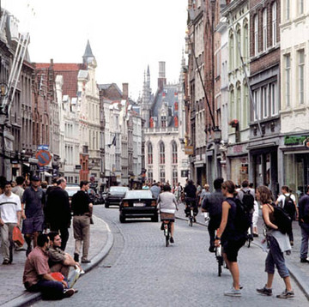
The Social Contexts

Slide 16
Evolutionary Process
Culture can render an adaptive phenotype highly maladaptive, e.g. food seeking
Human evolved in times of scarcity
Adapted for the ‘see food and eat it diet’
Adapted for energy conservation
Not adapted for quick/internal limitation
Modern Culture: High available cheap and aesthetically enhanced taste and textured food
OBESITY, DIABETES, HEART DISEASE

Slide 17
Science of compassion must begin with an understanding of
The ‘complex and often chaotic’ nature of the human mind
The components that create a compassionate mind
How to cultivate a compassionate mind
What undermines a compassionate mind

Slide 18
MESSAGE:
MOTIVES
ORGANISE THE MIND
Notes:
18

Slide 19
Sources of behaviour
Need compassion for a very tricky brain
Mindful Brain
New Brain: Imagination,
Planning, Rumination, Integration
Old Brain: Emotions, Motives, Relationship Seeking-Creating
COMPASSION

Slide 20
Sources of behaviour
Need compassion for a very tricky brain
Mindful Brain
New Brain: Imagination,
Planning, Rumination, Integration
Old Brain: Emotions, Motives, Relationship Seeking-Creating
Competitive

Slide 21
The Em0tions

Slide 22
Understanding our Motives and Emotions
Motives evolved because they help animals to survive and leave genes behind
Emotions guide us to our goals and respond if we are succeeding or threatened
There are three types of emotion regulation
Those that focus on threat and self-protection
Those that focus on doing and achieving
Those that focus on contentment and feeling safe

Slide 23
Types of Affect Regulator Systems
Drive, excite, vitality
Content, safe, connected
Non-wanting/
Affiliative focused
Safeness-kindness
Soothing
Incentive/resource- focused
Wanting, pursuing, achieving
Activating
Threat-focused
Protection and
Safety-seeking
Activating/inhibiting
Anger, anxiety, disgust
Notes:
23

Slide 24
Threat systems and phenotypes
Social contexts
offer different environments that
address, ignore or create stress
Early stress changes
Gene expression and
Neuro-development
Threat-focused
Protection and
Safety-seeking
Activating/inhibiting
Anger, anxiety, disgust
Notes:
24

Slide 25
Types of Affect Regulator Systems
Drive, excite, vitality
Content, safe, connected
Non-wanting/
Affiliative focused
Safeness-kindness
Soothing
Incentive/resource- focused
Wanting, pursuing, achieving
Activating
Threat-focused
Protection and
Safety-seeking
Activating/inhibiting
Anger, anxiety, disgust
Notes:
25

Slide 26
Lottery
£ $ £ $ £ $

Slide 27
Safeness,
Affiliation and affect regulation

Slide 28
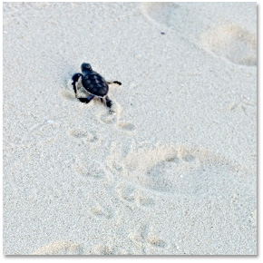
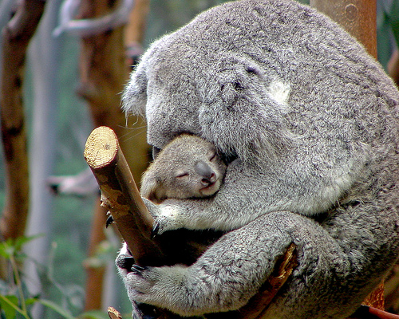
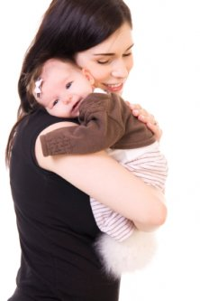

Slide 29
Types of Affect Regulator Systems
Drive, excite, vitality
Content, safe, connected
Non-wanting/
Affiliative focused
Safeness-kindness
Soothing
Incentive/resource- focused
Wanting, pursuing, achieving
Activating
Threat-focused
Protection and
Safety-seeking
Activating/inhibiting
Anger, anxiety, disgust
Notes:
29

Slide 30
Between self and others
Self to self
Self-to self
Calms
Affiliative/ Soothing
Threat
120 Million year evolving system to regulate threat
Notes:
30

Slide 31
Internal Threat and Soothing
Self-affiliation – experiences a lovable self
Calms
Affiliative/ Soothing
Threat
Internal representations of helpful others and sources of comfort
Neurophysiological networks
Emotional memories of soothing

Slide 32
Internal Threat and More threat
No self-affiliation – experiences a unlovable self
Calms
Affiliative/ Soothing
Threat
Others are threats or alarming
Neurophysiological networks
Emotional memories of no soothing

Slide 33
Being cared for and Physiology
The evolution of caring brings major changes in physiological regulation –
Relationships are physiological regulators
Gene expression
Stress reactivity
Immune system function
Frontal cortex
Illness and recovery
Core values
Self-identities
Compassion and empathy

Slide 34
so
Humans function best (frontal cortex, stress hormones, immune systems and cardiovascular) when they are
loving affiliative and caring (rather than hating)
Feel loved and valued (rather than unloved and de-valued)

Slide 35
Self and others
Self and self
Self-to self
Shame
Affiliative/ Soothing
Threat
120 Million year evolving systems to regulate threat
Social relationships are the most important sources of meaning, self regulation and learning
Notes:
35

Slide 36
Compassion solutions to the reality of suffering
Ancient wisdom: Compassion is the road to happiness (most spiritual traditions)
Evolution: Evolution has made our brains highly sensitive to external and internal kindness
Neuroscience: Specific brain areas are focused on detecting and responding to kindness and compassion
Social and developmental Psychology: History of affiliation affects brain maturation, emotion regulation, pro-social behaviour and sense of self
Notes:
36

Slide 37
Compassion and
Caring

Slide 38
The Two Psychologies of Compassion
Compassion can be defined in many ways:
As a sensitivity to the suffering of self and others with a deep commitment to try to relieve and prevent it
Two different Psychologies
  To approach, understand and (how to) engage with suffering
  To work/study to alleviate and prevent suffering –to nurture
Each more complex that might at first seem
Notes:
38
38

Slide 39
Compassion as Flow
Different practices for each
Other Self
Self Other
Self Self
Evidence that intentionally practicing each of these can have impacts on mental states and social behaviour
Notes:
39

Slide 40
Compassion Focused Therapy: and Social Mentality Theory
Caring/Help
Giving
Specific Competencies
e.g., attention empathy
Facilitators vs Inhibitors
Care/Help Seeking/Receiving
Specific Competencies
e.g., openness responsive
Facilitators vs Inhibitors
Not just interested in what compassion is – but how it is experienced as a recipient – experienced are “being cared about”

Slide 41
The Competencies of Compassion
Engagement and Alleviation

Slide 42
Compassionate Mind - Engagement
Warmth
Warmth
ATTRIBUTES
Sensitivity
Sympathy
Care for well-being
Compassion
Distress tolerance
Non-Judgement
Empathy
Warmth
Warmth
Notes:
42
42

Slide 43
Compassionate Mind - Alleviation
SKILLS -TRAINING
Warmth
Warmth
Imagery
Attention
ATTRIBUTES
Reasoning
Sensitivity
Sympathy
Compassion
Distress tolerance
Care for well-being
Feeling
Empathy
Behaviour
Non-Judgement
Sensory
Warmth
Warmth
Notes:
43
43

Slide 44
CULTIVATION
Practice of imagining compassion for others produces changes in frontal cortex and immune system (Lutz et al., 2009)
Loving kindness meditation (compassion directed to self, then others, then strangers) increases positive emotions, mindfulness, feelings of purpose in life and social support and decreases illness symptoms (Frederickson et al., 2008, JPSP)
Compassion self-goals in contrast to self-image goals are associated with feelings of connectedness and well-being (Crocker, J & Canevello (2008 JPSP) – voluntarily helping others boost positive emotions
Compassionate mind training reduces shame and self-criticism in chronic depressed patients (Gilbert & Proctor, 2006, CPP),
Notes:
44
44

Slide 45
Build the Compassionate Self
Method acting techniques – to pull on inner feeling and memories of a character – enter into the role – but why do it
Train in Wisdom – Evolved nature of mind and social construction to the self
Sense of calm mindful inner authority – body postures breathing, grounding and attention – courage to engage
Commitment to compassionate focus and action
Actual and imagery practices.

Slide 46
Compassion Process
Giving/doing
Mindful Acts of kindness
Engagement with the feared
Receiving/soothing
SBR/Calm
Grounding/stability
Validation
Gratitude appreciation
Compassionate
Self
Threat
Mindful awareness
Triggers
In the body
Rumination
Labelling
Notes:
46

Slide 47
Compassion as Ascent or Decent?
Compassion is not getting rid of the difficult contents of the mind but mindfully engaging with them (e.g., rage, fear prejudice) – going into, not away from
Compassion is becoming mindful and then being able to choose because it is not blaming but containing

Slide 48
Compassion as Flow
Different practices for each
Other Self
Self Other
Self Self
Evidence that intentionally practicing each of these can have impacts on mental states and social behaviour
Notes:
48
48

Slide 49
Data From Group Study
Notes:
49

Slide 50
Data From Group Study
Notes:
50

Slide 51
Reflections
I would just like to tell you all here today what (CMT) means to me. It seemed to awaken a part of my brain that I was not aware existed.
The feeling of only ever having compassion for other people and never ever contemplating having any for myself.
Suddenly realising that it’s always been there, just that I have never knew how to use it towards myself.
It was such a beautiful, calming feeling to know it was Ok to feel like this towards myself without feeling guilty or bad about it.
Being able to draw on this when I was frightened and confused, to calm myself down and to put things in prospective and say to myself “IT’S OK TO FEEL LIKE THIS.
Notes:
51

Slide 52
Reflections
Having compassion for myself means I feel so much more at peace with myself. Knowing that it is a normal way of life to have compassion for myself and it’s not an abnormal way of thinking, but a very healthy way of thinking. It felt like I was training my mind to switch to this mode when I start to feel bad about myself or life situations were starting to get on top of me.
What is striking about this, and what other participants thought, was how much they had (previously) felt that being self-compassionate and empathic to one’s distress was a self-indulgence or weakness and definitely not something to cultivate.
Notes:
52

Slide 53
Sources of behaviour
Need compassion for a very tricky brain
Mindful Brain
New Brain: Imagination,
Planning, Rumination, Integration
Old Brain: Emotions, Motives, Relationship Seeking-Creating
COMPASSION

Slide 54
Sources of behaviour
Need compassion for a very tricky brain
Mindful Brain
New Brain: Imagination,
Planning, Rumination, Integration
Old Brain: Emotions, Motives, Relationship Seeking-Creating
Competitive

Slide 55
Conclusion
Humans are capable of wonderful things, but also terrible things. Very mixed mind – many seeds
Our minds are really a mixed range of potential motives, ways of thinking and behaving – and we easily dissociate one state of mind from another
By improving our understanding of the nature of compassion, it’s facilitators and inhibitors, both as a giver and receiver, we may be better placed to cultivate the good in us. This is our responsiblity
How to bring this about?
Notes:
55

Slide 56
Some References
Gilbert, P (2009). The Compassionate Mind: A New Approach to the Challenge of Life. London: Constable & Robinson.
Gilbert, P. (2010) Compassion Focused Therapy: The CBT Distinctive Features Series. London: Routledge.
Gilbert, P & Choden. (2013). Mindful Compassion. London: Constable Robinson
See also the Compassionate Mind Series by New harbinger
With other author books on anxiety (Tirch), anger (Kolts)
, trauma (Lee), eating (Goss) and others

